Slide 1

Welcome
Cybersecurity & Threat Modeling
Notes:
Mandatory
ACTION: Adjust title to fit your course.

Slide 2
Prerequisites
This course assumes you:
Are interested in learning more about cybersecurity, its best practices, & threat modeling

Slide 3
Why study this subject?
In the modern digital age, security of our software & systems becomes paramount to our success as a business

Slide 4
My pledge to you
I will...
Make this interactive
Ask you questions
Ensure everyone can speak
Use an on-screen timer

Slide 5
Objectives
At the end of this course you will be able to:
Describe some common security attacks and threat modeling strategies
Notes:
Mandatory
ACTION: Adjust objectives to fit your course.
Use measurable objectives that start with action verbs such as: describe, define, identify, assess, demonstrate, use, utilize. https://elearningindustry.com/writing-learning-objectives-for-elearning-what-elearning-professionals-should-know

Slide 6
Agenda
Introduction
Cybersecurity
Threat modeling
Zero Trust Architecture (ZTA)

Slide 7
Introduction

Slide 8
How Software Engineers Test (Sometimes)
Manually
In a semi-automated fashion, but late in the SDLC
In large blocks of functionality requiring complex coordination

Slide 9
So, Why Is That a Problem?
Issues found late in the development workflow are more expensive to fix
Tests requiring complex coordination and setup are brittle
Without automation, testing takes more time and is more costly
Testing can be hard to “retrofit” into a design not built for it

Slide 10
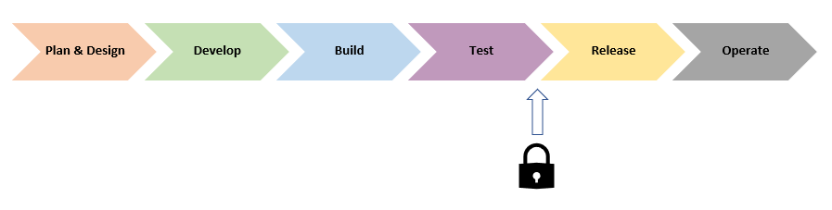
How Software Engineers Think About Security (Sometimes)

Slide 11


How Software Engineers Think About Security (Sometimes)
At times as engineers we might try to rely on “security by obscurity”
Instead of explicitly implementing specific practices built to make our systems more secure, we’ll hope that vulnerabilities are “buried” deep enough in the codebase that an attacker would have difficulty finding and exploiting them
This might work for a human attempting manual attacks – however, in modern software engineering, attackers leverage massive amounts of processing power in a “brute force” manner to automate discovery and exploitation!
Notes:
Remember – just as you are working to learn and evolve in the area of technology for being productive and doing good, there are other nefarious actors working to learn and evolve for causing harm and doing bad

Slide 12
How Software Engineers Think About Security (Sometimes)
An afterthought
As a concern right before release
“Not my area of expertise…”

Slide 13
So, Why Is That a Problem?
Issues found late in the development workflow are more expensive to fix
Security issues can be complex to remediate and endanger release schedules
Potential for significant financial and/or reputational damage

Slide 14
Opportunities
Raising awareness of common threats & attack vectors
Practicing threat modeling techniques to help assess and focus
Learning to design for testability
Integrating quality gates for testing and security into your CI/CD pipelines

Slide 15
Cybersecurity

Slide 16
Common Security Attacks
Denial of Service (DoS or DDos)
SQL injection
Large files
Cross Site Scripting (XSS)
Credential stuffing

Slide 17
Denial of Service (DoS)
Server “flooded” with so much bogus traffic that systems are unable to serve valid requests
Alternatively, instruction(s) received that trigger a server or system “crash”

Slide 18
Denial of Service (DoS)
Common flooding attacks:
Buffer overflow (most common type)
ICMP flood (AKA “smurf attack” or “ping of death”)
SYN flood
Notes:
Buffer overflow attacks – the concept is to send more traffic to a network address than the programmers have built the system to handle
ICMP flood – leverages misconfigured network devices by sending spoofed packets that ping every computer on the targeted network, instead of just one specific machine; the network is then triggered to amplify the traffic
SYN flood – sends a request to connect to a server, but never completes the handshake; continues until all open ports are saturated with requests and none are available for legitimate users to connect to
Client requests connection by sending SYN (synchronize) message to the server
Server acknowledges by sending SYN-ACK (synchronize-acknowledge) message back to the client
Client responds with an ACK (acknowledge) message, and the connection is established

Slide 19
Denial of Service (DoS)
Crash attacks:
Often involves send of data targeting common classes of bug
Request used to crash or severely destabilize the system

Slide 20
Distributed Denial of Service (DDoS)
Similar profile as DoS but uses multiple systems to orchestrate the attack
Provides attacker with advantages

Slide 21
Distributed Denial of Service (DDoS)
Potential advantages for attacker:
More agents means more power behind the attack
Location of attack is difficult to detect (often globally-routed)
Easier to shut down a single attack machine than multiple
Identity of attacker is more easily disguised

Slide 22
Defending Against Denial of Service
Ensure service has good AuthN/AuthZ in place
Utilize a proxy or gateway and configure throttling
In Production, disable ICMP pings or use rate-limit for ICMP requests (e.g., using iptables)
Notes:
ICMP = Internet Control Message Protocol

Slide 23
Defending Against Denial of Service
Minimize server resources allocated to an incoming sync request
Use a form of “cookie” for managing sync requests
SYN cookies and RST cookies are examples
Mitigation often involves configuration of network components or layers
Notes:
SYN cookies – server sends sequence number cryptographically hashed on syn-ack response; client must respond with same before server allocates mem for connection
RST cookies – server sends invalid syn-ack in response to first client request; results in client sending an RST packet – if server sees, knows client is a valid connection

Slide 24

DEMO
Denial of Service
Notes:
Walk through demo at https://github.com/KernelGamut32/onboarding_cybersecurity/tree/main/demos/denial_of_service

Slide 25
SQL Injection
Attacker injects SQL (Structured Query Language) queries into app flow (e.g., UI)
In some cases, injected SQL used to retrieve additional sensitive detail
In other cases, injected SQL used to alter or damage a company’s critical data

Slide 26
Types of SQL Injection Attack
In-band
Blind

Slide 27
In-band SQL Injection
Uses existing channel of communication for an attack
Error-based – attacker performs actions that cause errors in order to gather “intel” about database structure
Union-based – attacker takes advantage of UNION SQL operator to fuse multiple SELECT statements into single response

Slide 28
Blind SQL Injection
Attacker sends separate, independent data queries to a server
Called blind because results of query are not sent back to attacker
Instead, attacker observes results to infer vulnerabilities

Slide 29
Blind SQL Injection
Relies on response and behavior patterns of server so slower to execute
Boolean – attacker sends SQL query to database and determines if attack valid based on response received (true or false)
Time-based – attacker sends SQL query to database and determines if attack valid based on amount of time taken to process

Slide 30
Defending Against SQL Injection
Use well-defined contracts to explicitly map expected results from application
Sanitize inputs and use parameterized queries in code
Use a Web Application Firewall that includes protections at the application layer (including protection against SQL Injection)

Slide 31
DEMO
SQL Injection
Notes:
Walk through demo at https://github.com/KernelGamut32/onboarding_cybersecurity/tree/main/demos/sql_injection

Slide 32
Large Files
Sometimes resembles another form of Denial of Service
Attacker attempts to send one (or several) very large files as upload
Could also occur with extremely large payloads (JSON or XML bodies)
As a result, network connectivity to servers or services can become “clogged”

Slide 33
Defending Against Large Files
Use configuration to limit file/payload sizes and number of concurrent connections from a client
Utilize timeouts judiciously to prevent large file operations from completing
Can also leverage MIME types as a way to limit acceptable types of data
Finally, proxies or gateways (WAF) can be configured for mitigation at the network layer

Slide 34
Cross Site Scripting (XSS)
A type of injection – but script instead of SQL
Attacker uses inputs to attempt injection of a <script>…</script> element
An example could be posting a comment with a link that routes to a malicious site

Slide 35
Cross Site Scripting (XSS)
Without inspection for malicious content, <script> can be returned (and executed) in user’s browser
Malicious content can include JavaScript, HTML, Flash, etc.
Really, any code that browser can execute

Slide 36
Cross Site Scripting (XSS)
Common forms of attack:
Stealing cookie or session information
Redirects to web content controlled by an attacker
Executing malicious operations on user’s machine
Leveraging impersonation for elevated privilege

Slide 37
Cross Site Scripting (XSS)
Stored XSS attacks:
Injected script permanently stored on target servers
Could include storage in database, forum, comment field, etc.
Malicious script returned to browser as part of retrieval from storage
Notes:
On a profile page (social media), attacker applies script to one of their profile settings; victim visits profile page for that user, malicious code pulled from storage and executed – for example, redirecting to a malicious site where credentials can be stolen

Slide 38
Cross Site Scripting (XSS)
Reflected XSS attacks:
Malicious script is indirectly transferred back to browser
When user clicks on malicious link, code gets injected into vulnerable site
Malicious code then reflected back to user under the cover of “valid” site interaction for immediate execution
Notes:
For example, attacker sends link to victim which includes a path to a search sight with search terms in query string that is malicious code; victim clicks link and it reflects back the malicious code for immediate execution

Slide 39
Cross Site Scripting (XSS)
DOM-based XSS attacks:
Takes advantage of sites that copy input to DOM without validation
Similar to reflected in that victim is tricked into sending malicious code to vulnerable site
However, input lands in DOM in the browser for execution instead of being reflected back
Notes:
For example, a site that takes query string input and writes dynamically to an element in the DOM (for execution by the browser)

Slide 40
Defending Against Cross Site Scripting
Encode and validate everywhere – do not trust user inputs, escape outputs, and manage response headers
Use libraries with utility handlers where possible (e.g., Jinja or Django)
Quote every attribute of every tag in HTML

Slide 41
Defending Against Cross Site Scripting
Use HttpOnly directive on custom cookie response headers (i.e., “Set-Cookie” header)
Use the “X-Content-Type-Options: nosniff” to prevent MIME type sniffing (i.e., dynamic changes to Content-Type header)
Leverage network components like WAF with built-in protection to intersect at the network layer
https://cheatsheetseries.owasp.org/cheatsheets/Cross_Site_Scripting_Prevention_Cheat_Sheet.html
Notes:
HttpOnly default for session cookies, but should also be used for any custom cookies created
X-Content-Type-Options: nosniff is likely default in modern frameworks but confirm

Slide 42
DEMO
Cross Site Scripting
Notes:
Walk through demo at https://github.com/KernelGamut32/onboarding_cybersecurity/tree/main/demos/xss

Slide 43
Credential Stuffing
Attackers use lists of compromised credentials to try and find a breach
Based on assumption that many users reuse same credentials across sites
Uses bots, automation, and scale

Slide 44
Credential Stuffing
Like a brute force attack
However, instead of random strings, uses existing lists of known credentials
Powered by broad availability of compromised info and increasing sophistication of bots & automation
Notes:
More sophisticated bots that simultaneously attempt several logins and appear to originate from different IP addresses

Slide 45
Credential Stuffing
Attacker sets up bot able to attempt login for multiple accounts in parallel
Uses an automated process to test effectiveness
Monitors for breaches and pulls/retains sensitive detail when found
With parallel attempts, often fakes IP addresses to make difficult to trace

Slide 46
Defending Against Credential Stuffing
Leverage MFA (Multi-Factor Authentication)
Use a CAPTCHA (though I hate them!)
Gather details about user devices to create a “fingerprint” for incoming sessions – if same “fingerprint” is logged several times in sequence, block
Notes:
Something the user knows + has
Fingerprint can include things like combo of OS + geolocation + language (gathered via JavaScript)

Slide 47
Defending Against Credential Stuffing
Leverage IP blacklisting
Rate-limit non-residential traffic sources (like public Cloud)
Block headless browsers based on JavaScript calls used
Disallow e-mail addresses as user IDs

Slide 48
OWASP Top 10
See https://owasp.org/Top10/
Can change from year-to-year so be aware

Slide 49
Threat Modeling

Slide 50
Standards & Compliance
Can include:
By geographical location
By industry
By technology

Slide 51
Standards & Compliance by Region
Standards and compliance enforcement can vary by area of the world
For example, EU likely has different requirements than US (e.g., General Data Protection Regulation or GDPR in EU)

Slide 52
Standards & Compliance by Region
Can include considerations for:
How data is transmitted
How data is secured, managed, & used
Physical or systems security

Slide 53
Standards & Compliance by Region
Failure to adhere can limit ability to do business in the region
Or can result in significant penalties and/or reputational damage
Can add permutations to approach to build out of the tech

Slide 54
Standards & Compliance by Industry
Different industries may have different regulations
There can also be a difference in physical requirements
Think remote oil field vs. data center vs. nuclear power plant

Slide 55
Standards & Compliance by Industry
Regulations often driven by types of data being gathered
Medical devices likely subject to HIPAA regulations
Point-of-Sale (POS) devices likely require PCI compliance

Slide 56
Standards & Compliance by Industry
Depending on the industry, failure to comply may have devastating impact
Think potential exposure for communications backbone, air traffic control, or autonomous vehicles

Slide 57
Standards & Compliance by Technology
Each technology stack brings with it different layers of exposure
Requires vigilance, monitoring, & willingness to adjust as and when needed
Areas of potential exposure range from OS to runtime to Open-Source libraries used in application
Notes:
When we talk DevSecOps, we’ll talk about some of these concerns

Slide 58
Assessing Security Risks
To secure a solution, attack surfaces and potential threats must be identified
Common practice utilizes something called threat modeling
Includes modeling and analyzing possible attack vectors based on application

Slide 59
Assessing Security Risks
Risk assessment should account for different “zones” of execution
Security requirements must be understood in context of specific use cases
Ideally, threat modeling would be executed during design & dev phases
Hardware
Software
Network
Database

Slide 60
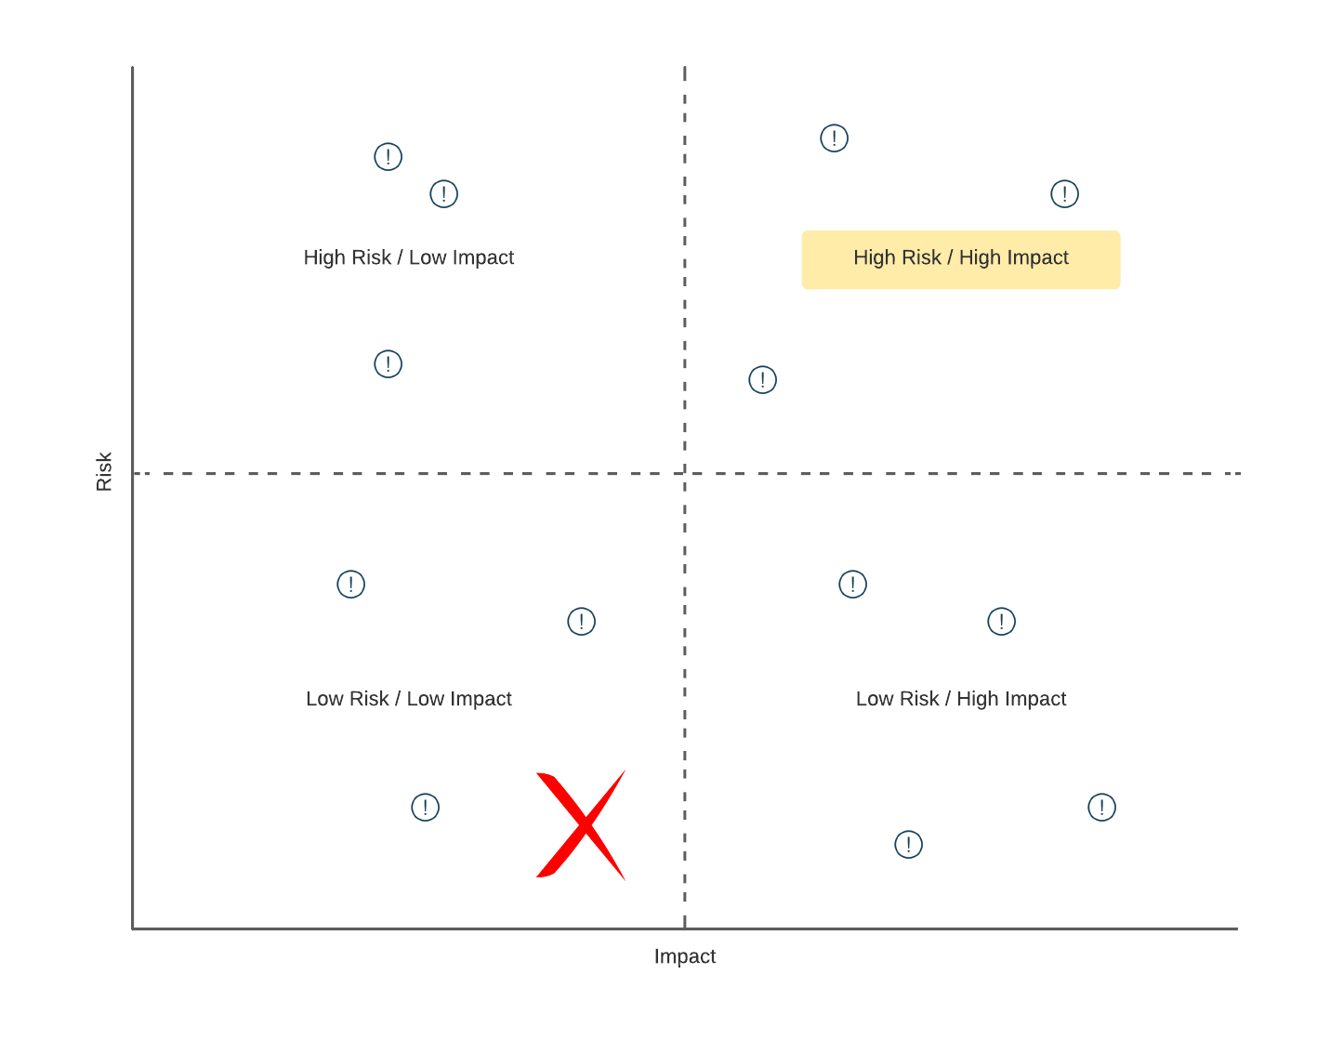
Threat Modeling

Slide 61
Threat Modeling
Can be viewed in two different, but related, contexts:
Implementation of controls mapped to security requirements & policy (prevention)
Implementation of countermeasures against possible known attacks (remediation)

Slide 62
Threat Modeling
Multiple approaches:
Attacker-centric (think like an attacker!)
Asset-centric (what do we have to lose?)
Application-centric (what are we building & testing?)

Slide 63
Threat Modeling – Attacker-Centric
Involves profiling potential attacker’s characteristics, skillset, & motivation
Grouped by type of attacker and, hence, type of attacks
Examples include attacker looking to steal sensitive information, hold a company’s data or systems “hostage”, or disrupt service

Slide 64
Threat Modeling – Attacker-Centric
Utilizes tree diagrams to map combinations:
Goals of attacker
Specific system-related considerations
Potential attack methods
Means for detection/mitigation

Slide 65
Threat Modeling – Attacker-Centric
In some cases, potential attacks can be mapped to known patterns
Goal is to view your system (and its vulnerabilities) through the eyes of a “bad actor” looking to attack
Notes:
With known patterns able to build a library of mitigations – but can’t ease up on vigilance
An example would be an attack to obtain information from a backend database; attacker needs to ensure that database is being used at the backend, have means to enter queries as input, and avoid detection/prevention (SQL Injection)

Slide 66
Threat Modeling – Asset-Centric
Involves identifying the specific software & data assets of an organization
Data assets often classified by sensitivity and intrinsic value to an attacker – helps with prioritization
Uses attack graphs to visually illustrate patterns of potential attack against a given asset
Notes:
For example, obviously SSNs would be viewed differently than a person’s home state
Depending on the org, the initial identification step can be more difficult
Can you think of reasons for some of that difficulty in a given company?

Slide 67
Threat Modeling – Application-Centric
Involves the security design of the system
Security requirements (like other application requirements) gathered and prioritized
Application functionality built to address the requirements (SDLC)
Frameworks exist to assist a team with asking the right questions
Notes:
For example, Well-Architected frameworks with Azure or AWS, etc.

Slide 68
Threat Modeling – Key Considerations
Valuable principles:
Defense in Depth
Principle of Least Privilege
Secure by Default

Slide 69
Securing Data in Motion
Security required as data flows through the ether between producer and consumer
If attacker able to intercept information flowing between the two:
Potentially exposes sensitive information contained within header or payload
Could allow insertion of alternate, damaging alternative information

Slide 70
Securing Data in Motion
Certificate/secrets-based Transport Layer Security (TLS) can be used to protect
Leverages certs/keys to encrypt data “on the wire”

Slide 71
Securing Data at Rest
If data at rest (stored & aggregated data) compromised:
May lead to inaccurate conclusions from analysis
Could provide competitor or bad actor access to a company’s competitive advantage
As with “in motion”, certificate-based encryption in storage is key

Slide 72
Threat Modeling Tools & Frameworks

Slide 73
OWASP Threat Dragon
https://owasp.org/www-project-threat-dragon/
Notes:
Review demonstration link and representative threat modeling diagram
Drill into pytm

Slide 74
PASTA
https://www.cynance.co/pasta-threat-modelling/

Slide 75
OCTAVE
https://www.pluralsight.com/guides/cybersecurity-threat-modeling-with-octave

Slide 76
STRIDE
https://securityintelligence.com/articles/what-is-stride-threat-modeling-anticipate-cyberattacks/

Slide 77
Comparison of Various Options
https://www.eccouncil.org/threat-modeling/
https://www.techwell.com/techwell-insights/2020/05/choosing-right-threat-modeling-methodology

Slide 78
Principles & Elements of ZTA

Slide 79
Zero Trust prompting shift from network-centric trust models…
… to identity-centric capabilities
Traditional Information Security ecosystem is based on a legacy 'Castle and Moat' model, built on the foundation of Perimeter Security
The exterior is well-guarded against threats, but once bypassed, few defenses stand between an attacker and the 'crown jewels'
New concept allows for a 'Hotel' model that explicitly distrusts network connections and builds trust based on continuous enforcement of enterprise policies
Hotel requires credentials to authorize a key, which can be used to access specific hotel resources such as elevators and rooms
79

Slide 80
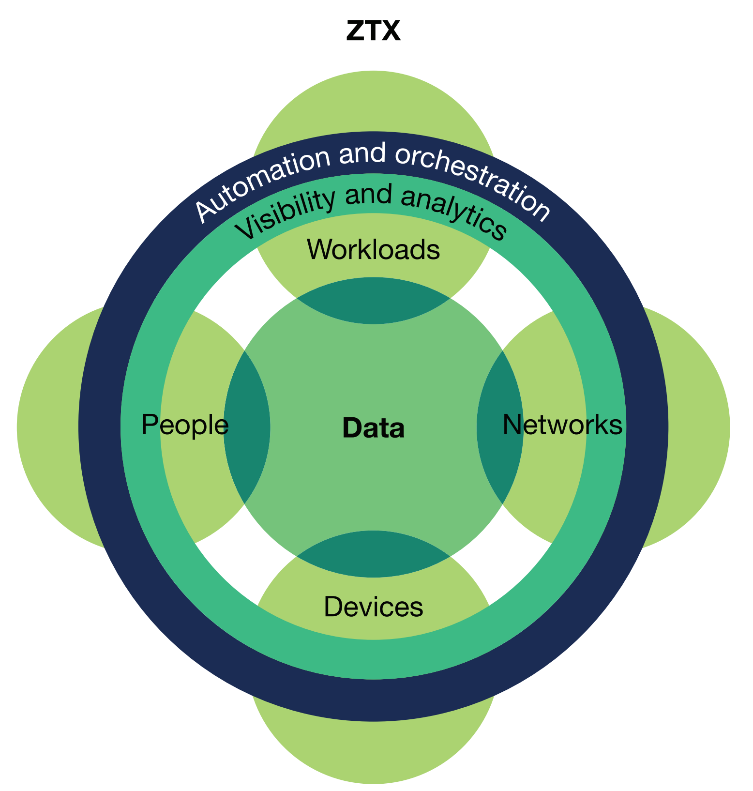
Forrester’s Zero Trust Extended Model (ZTX)
Forrester Zero Trust eXtended Model (Source: A Practical Guide to a Zero Trust Implementation, Forrester Research, Inc., March 2021)

Slide 81
Forrester’s Zero Trust Extended Model (ZTX)
Data
In today’s digital age, data is the competitive advantage
At the center of what is to be protected
Data Classification, Protection, and Loss Prevention are key concerns
Need contextual access policies based on attributes of accessor
Protection of Data (a.k.a Value) as a Central Concern
Forrester Zero Trust eXtended Model (Source: A Practical Guide to a Zero Trust Implementation, Forrester Research, Inc., March 2021)
Notes:
Competitive advantage – what we have, what we can learn from it, how it drives our business and innovation → and the amount continues to grow exponentially

Slide 82
Forrester’s Zero Trust Extended Model (ZTX)
Networks
Focus is network segmentation
Granular levels of access and access checks based on identity-centric attributes
Will likely include multiple of the “traditional” network components
Difference is how and when access is verified
Zero Implicit Trust at the Network Layers
Forrester Zero Trust eXtended Model (Source: A Practical Guide to a Zero Trust Implementation, Forrester Research, Inc., March 2021)
Notes:
Networks have likely always been under consideration but not at the levels of granularity needed

Slide 83
Forrester’s Zero Trust Extended Model (ZTX)
People
Includes user & non-user identities
Identity & Access Management (IAM)
Role-Based Access Control (RBAC)
Attribute-Based Access Control (ABAC)
Multi-Factor Authentication (MFA)
Single Sign-On (SSO)
Knowing Who You Are and What You’re Allowed To Do
Forrester Zero Trust eXtended Model (Source: A Practical Guide to a Zero Trust Implementation, Forrester Research, Inc., March 2021)
Notes:
ABAC is a superset that includes RBAC / how do we know who you are and what you’re allowed to do, and control access dynamically

Slide 84
Forrester’s Zero Trust Extended Model (ZTX)
Workloads
Components of logical business functions
Things like processes, containers, applications, infrastructure, etc.
Use metadata and context to define and enforce required access controls
Security of a Workload is Dictated by the Security of Its Components
Forrester Zero Trust eXtended Model (Source: A Practical Guide to a Zero Trust Implementation, Forrester Research, Inc., March 2021)

Slide 85
Forrester’s Zero Trust Extended Model (ZTX)
Devices
Includes both corporate as well as BYOD
As with users, device & device access need to be secured
Cataloging & control are key
Attributes & context drive access control
Ecosystem of Devices Represents Additional Vectors of Attack
Forrester Zero Trust eXtended Model (Source: A Practical Guide to a Zero Trust Implementation, Forrester Research, Inc., March 2021)
Notes:
For example, dynamically isolating a device if it’s not updated to the latest version of its anti-virus software

Slide 86
Forrester’s Zero Trust Extended Model (ZTX)
Visibility & Analytics
Access to data to inform assessment of security posture & security decisions
Likely requires aggregation across multiple, disparate data sources
Can help with operational concerns as well as compliance concerns
It’s Hard to Fix Critical Security Concerns That You’re Unaware Of
Forrester Zero Trust eXtended Model (Source: A Practical Guide to a Zero Trust Implementation, Forrester Research, Inc., March 2021)

Slide 87
Forrester’s Zero Trust Extended Model (ZTX)
Automation & Orchestration
Zero Trust is intended to be inherently dynamic and able to adapt quickly
Automating manual processes is critical to ability to react quickly to security exposure
Can include more sophisticated assessments that automatically account for & adjust to changing attributes & context
Security Exposure Needs to be Identified & Remediated As Quickly As Possible
Forrester Zero Trust eXtended Model (Source: A Practical Guide to a Zero Trust Implementation, Forrester Research, Inc., March 2021)

Slide 88
What Problem(s) Are We Trying to Solve?
Traditional perimeter-centric model has proved insufficient at securing our enterprise
Requires downstream components to make potentially damaging assumptions about valid access
Does not account for dynamic nature of networking & systems integration
Need an approach that can bring value today and evolve over time
Increasing complexity at the network layer, unchecked implicit trust, and “any device anywhere” all breed risk
88
Notes:
Once we’re “in the front door”, can we really assume that we’re allowed to do whatever we want on the inside?
Inherent or implicit trust (sans a well partitioned PEP) breeds risk – we want the level of those types of trust to be zero
Bringing a new device or user on – how can we be sure that we have accounted for all of the necessary controls | and what if something changes from the initial point of evaluation?
Our networking environments can become complex and grow in complexity over time

Slide 89
Some Key Zero Trust Principles to Consider
All resources require secure access without regard for location
Strategy should be one of least privilege with strict enforcement
Inspect / log all traffic – every connection is a potential payload
Favor components that support APIs for programmatic data exchange
Use context, attributes, and events to automate security actions\
Target both tactical and strategic value – business-driven
Notes:
- Today’s remote workloads – COV-ID has elevated awareness
- Managing via broad access to networks and apps is no longer sufficient
- Logging – balance against network and storage costs; but goes to required visibility
- APIs provide options to aggregate and analyze data from multiple components in more interesting ways
- Automation is intelligent automation – decisions made “on the fly” about a security posture and a required mitigation
- Likely requires effort, cost, and will cause disruption – effort over time, draw connection to business-value

Slide 90
Zero Trust Architecture
Context
Ongoing Risk Assessment
Automation
Identity & Attributes
Multiple & Repeated Checks
Quickly at Volume & Scale

Slide 91
Security as a Software Architect & Software Developer Responsibility
DevSecOps seeks to “shift security left”
The earlier in the SDLC that we identify and fix issues (including security issues), the cheaper
Security can be complex – requires vigilance from the entire team
It only takes one “weak link” to endanger the “chain”
91

Slide 92
Security as a Software Architect & Software Developer Responsibility
Security is not a network component-only concern
Applications & data are resources that also need strict access controls
Siloes are ineffective – planning, design, & implementation require coordination as a “vertical slice” across all functions
Understanding & accounting for the impact of enhanced security controls help facilitate the absorption of any corresponding impacts
92

Slide 93
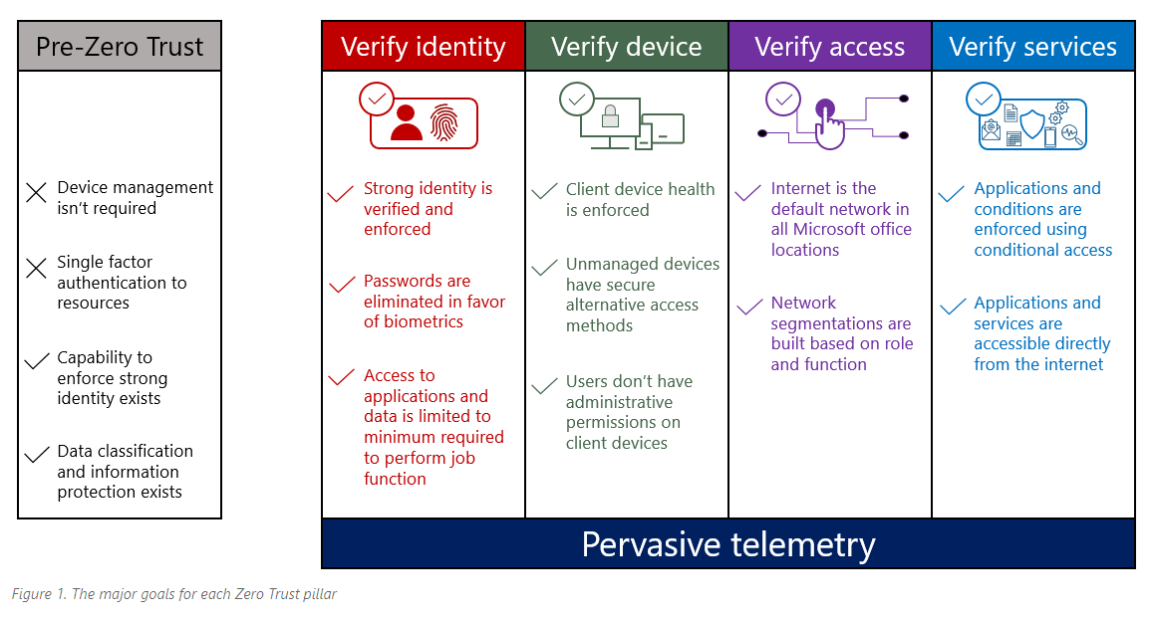
Microsoft’s Zero Trust Architecture
Source: https://www.microsoft.com/en-us/insidetrack/implementing-a-zero-trust-security-model-at-microsoft?SilentAuth=1&wa=wsignin1.0

Slide 94
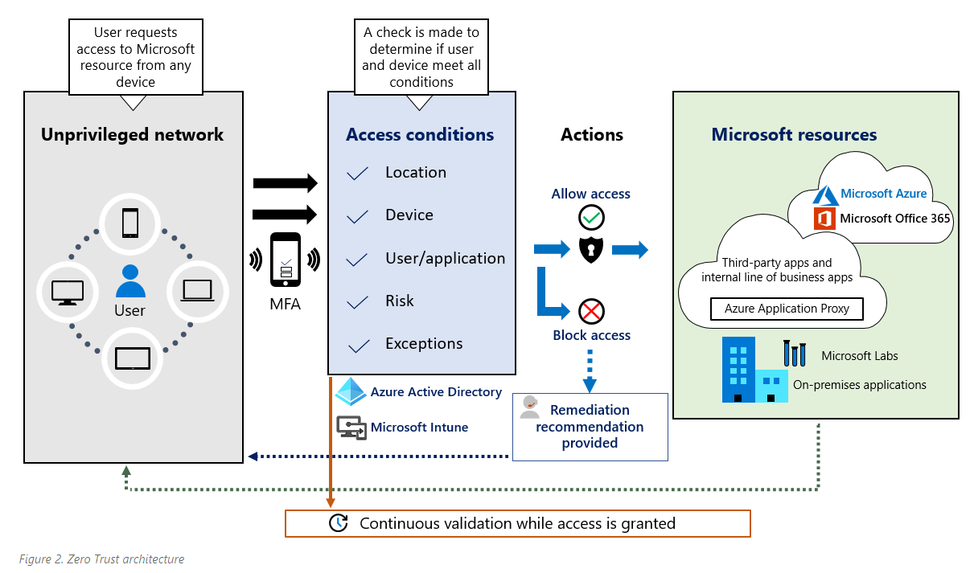
Microsoft’s Zero Trust Architecture
Source: https://www.microsoft.com/en-us/insidetrack/implementing-a-zero-trust-security-model-at-microsoft?SilentAuth=1&wa=wsignin1.0

Slide 95



Multiple Views
Architect
Software Engineer
Security gaps in the architecture?
List of components requiring protection?
Security standards & best practices?
Patterns we can use to help ensure secure integration?
Are we following “defense in depth”?
Security hooks to be included in code flows?
Tooling/libraries that make the job of securing the app “easier”?
Is code clean?
Sufficient testing?
Performance impacts?
Where are the exposure points in the network layer?
Are my “implicit trust zones” right-sized?
Monitoring in place?
How quickly can we remediate an uncovered vulnerability?
Network Engineer

Slide 96
Implementing ZTA

Slide 97
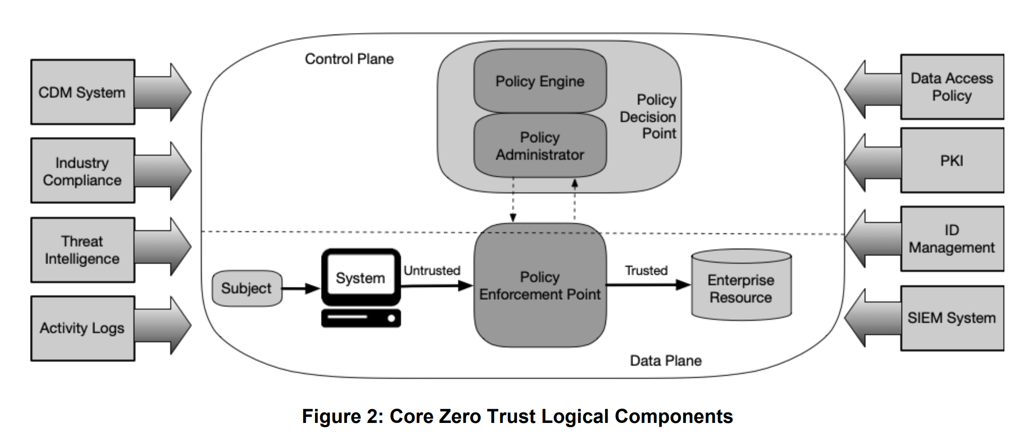
Logical Components of Zero Trust
Core Zero Trust Logical Components (Source: Zero Trust Architecture, NIST SP 800-207, August 2020)

Slide 98
Logical Components of Zero Trust
The only way for a subject (presumed to be untrusted) to access a resource; does not make policy decisions
Centralized place where policy is defined, and decisions are made on behalf of distributed PEPs
Application, data, document, or workload controlled by enterprise and to be protected by ZTA
User, application, or device with access to an Enterprise Resource
Core Zero Trust Logical Components (Source: Zero Trust Architecture, NIST SP 800-207, August 2020)

Slide 99
What is a Policy?
Subject Criteria
Action
Target
Condition

Slide 100
What is a Policy?
Subject Criteria
Action
Target
Condition
Subjects are authenticated entities initiating actions
Criteria determines which subject(s) policy applies to
e.g., “Users who are members of the group HR-Managers in Azure Active Directory”

Slide 101
What is a Policy?
Subject Criteria
Action
Target
Condition
Activity to be performed by subject
Must reference a network or application component (or both)
e.g., “Users have access to the API on port 51050 using HTTPS”

Slide 102
What is a Policy?
Subject Criteria
Action
Target
Condition
Resource upon which the action is to be performed
Can be statically or dynamically defined
Can be broad or narrow in scope (narrow is the preference)
e.g., “Compensation API at compensation.com/api”

Slide 103
What is a Policy?
Subject Criteria
Action
Target
Condition
Condition(s) under which subject is allowed to perform action on target
Must support definition in terms of multiple types of attributes
e.g., “Users must be on-premise and configured with MFA”

Slide 104
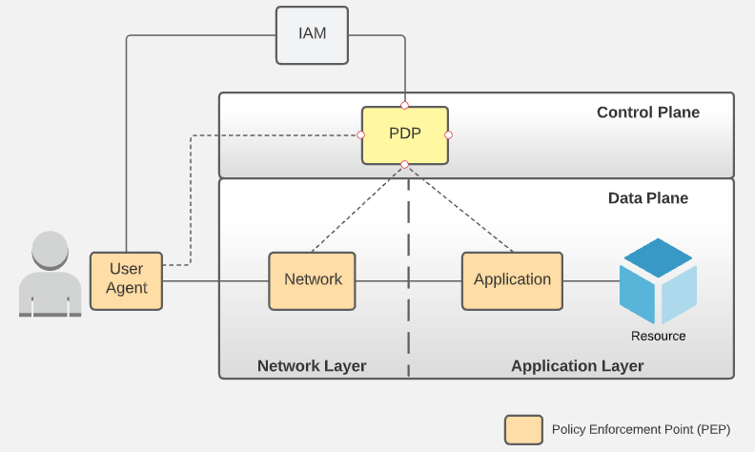
Types of Policy Enforcement Point (PEP)
Different levels, types, and combinations of PEP can contribute to the overall security of a workflow

Slide 105
Types of Policy Enforcement Point (PEP)
User Agent PEP
Components that run on a user’s device
Help enable Zero Trust conditions for secure connectivity from remote connections
Pass attributes about the device to the PDP for factor into policy application
Notes:
For example, requirements for an encrypted connection

Slide 106
Types of Policy Enforcement Point (PEP)
Network PEP
May already be in place
Next-Generation Firewalls can be considered a type of Network PEP
Enforcement often able to be performed inline, including actions based upon inspection of traffic or data about the traffic (metadata)

Slide 107
Types of Policy Enforcement Point (PEP)
Application PEP
Might be external or internal to the application to which it is applied
Could be part of the application itself
Regardless, as with all PEPs, requires a level of integration with the centralized PDP
Notes:
Target infrastructure and architecture should be composed of a series of PEPs – with centralized decisioning, operational connectivity between them, and integrated with a shared policy model

Slide 108
Securing the Components of a System
Key Concepts:
A larger system is only as secure as the components that compose it
Follow Zero Trust principles and policies in the build of those subcomponents
Use frameworks that ensure Zero Trust to the lowest levels of granularity
The sum of the secure parts make up the secure “whole”
Result should be a set of reusable components that are “secure by design”
High-Level “Wrapping” Component
Subcomponent A
Subcomponent A1
Subcomponent A2
Subcomponent B
Subcomponent B2
Subcomponent B1

Slide 109
What Makes a “Good” PEP?
Must be able to enforce identity-centric and context-aware policy model as managed by the PDP (requires integration with the PDP)
When changes to policy occur within the PDP, must be able to respond automatically and dynamically
Maintain controlled and secure integration with the PDP
109

Slide 110
What Makes a “Good” PEP?
PDP
PEP
PEP is programmatically driven by PDP
PEP can receive ongoing updates from the PDP
PEP can respond dynamically, automatically adjusting policies as required based on identity and context-aware policy detail
The good news: leveraging BCG platforms like SMP and the Enterprise Cloud provide you with effective PEPs “out-of-the-box”
Notes:
Automated doesn’t mean that there can’t be some level of manual step involved (e.g., manual approval of requests for access), but the majority of activity should be automatic.
If you want your implementations to be secure according to Zero Trust Architecture principles, one of the “easiest” ways is to use the frameworks and tooling provided for you.

Slide 111
Typical Deployment Models
Resource-Based Deployment Model
Enclave-Based Deployment Model
Cloud-Routed Deployment Model
Microsegmentation Deployment Model
111

Slide 112
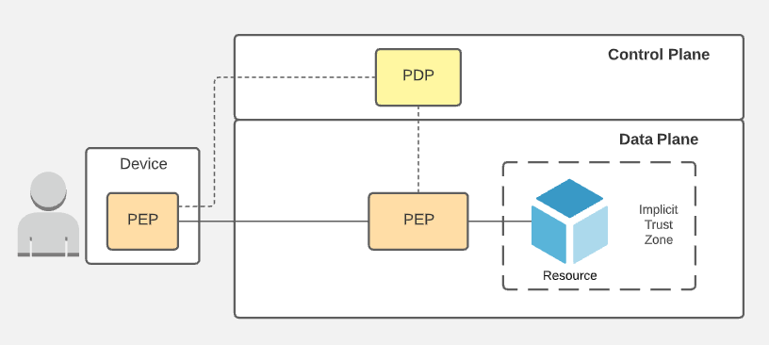
Resource-Based Deployment Model
User Agent PEP on the device
PEP that sits directly in front of a resource
Implicit trust zone is the area that sits behind the PEP in which all contained resources are trusted equally
Model helps to minimize size of any given zone
Pros
More granular end-to-end control
Compact implicit trust zone
Cons
1-to-1 correlation between PEP and resource
End-to-end secured conduit can obfuscate interaction between resources from inline security controls

Slide 113
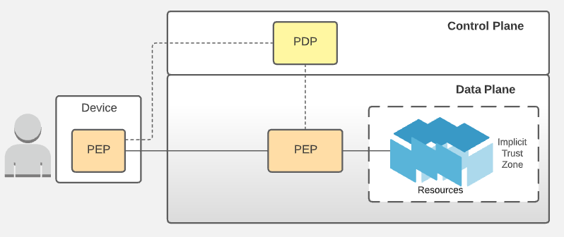
Enclave-Based Deployment Model
User Agent PEP on the device
PEP that sits directly in front of a group of resources
Implicit trust zone more coarse-grained
Pros
Simpler to deploy and maintain (less PEPs)
Well-suited for ephemeral workloads and dynamic environments
PEP could serve as an ingress point on the edge to provide remote access to a set of trusted resources
Cons
Potentially large implicit trust zone
If PEP is used as ingress, must be secured, monitored, and maintained

Slide 114
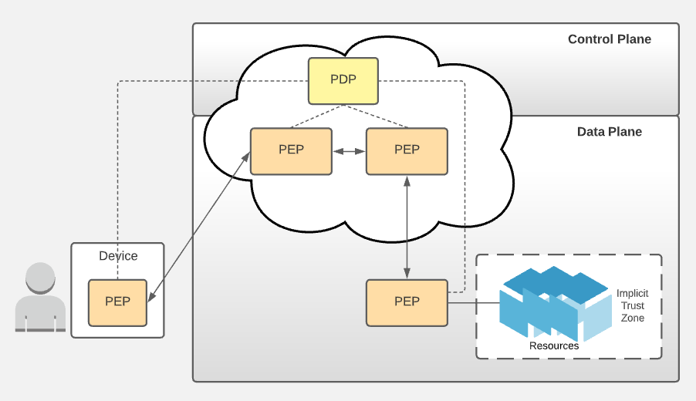
Cloud-Routed Deployment Model
Traffic from subject routed through a cloud environment
PEPs in the enterprise act as connectors to PEPs in the cloud
Traces an enforcement flow from device to cloud to resource
Pros
Simplifies setup
Shift to managed services reduces operational load
Cons
Adds latency to traffic flow
Requires diligence to ensure cloud resources are sufficiently secured
Less responsibility but also less control
Notes:
Would not use for cases where on-prem subject needs to access on-prem resource – unnecessary flow through cloud

Slide 115
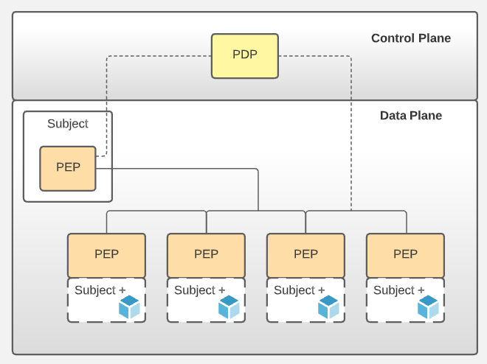
Microsegmentation Deployment Model
For server-to-server use cases
Resources vs. users
Resources represent authenticated entities between which connectivity is secured via PDP & PEP
Pros
Small implicit trust zone (scoped to a specific resource)
Enables bidirectional control of access between resources (e.g., between integrated microservices)
Cons
1-to-1 correlation between PEP and resource
Can lead to increased complexity and maintenance depending on the level of required service integration

Slide 116
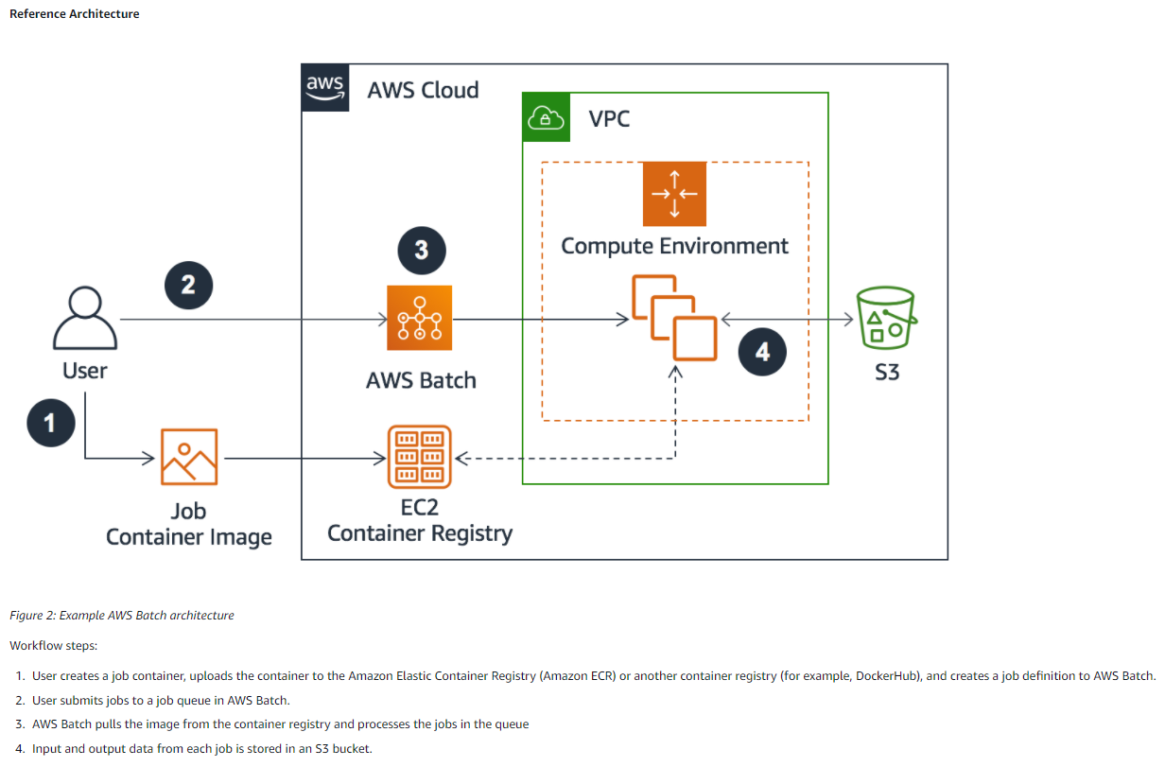
Where’s Waldo? (I mean, Where are the PEPs?)
Source: https://docs.aws.amazon.com/wellarchitected/latest/high-performance-computing-lens/batch-based-architecture.html

Slide 117
Zero Trust Networking

Slide 118
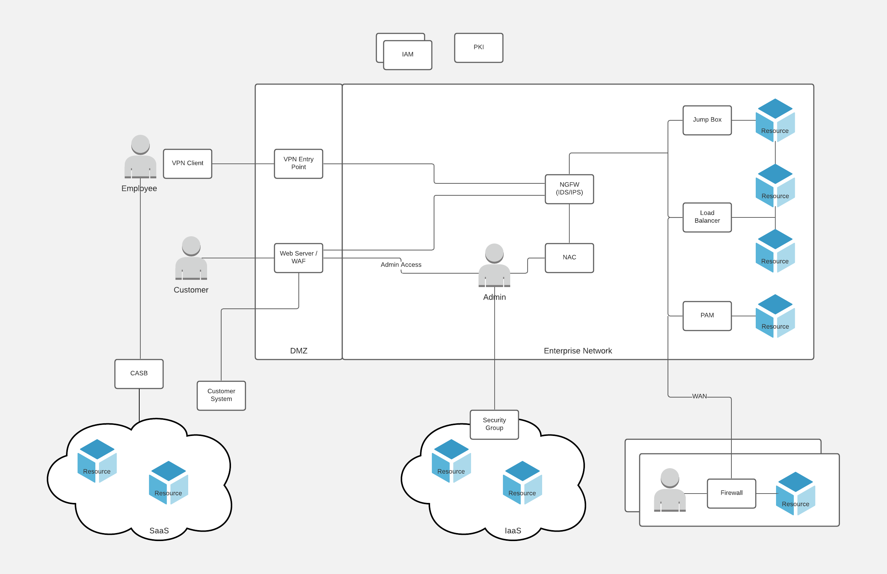
Traditional Enterprise Network
Includes many of the same components you might see in a ZTN
Difference is in where access is checked
Traditional network checks at perimeter but then assumes security “behind the firewall”
Also, enforcement is more static

Slide 119
Zero Trust Network (ZTN)
Zero Trust philosophy – “never trust, always verify”
Build networks around microperimeters (or secured subsets of sections of the network)
Each microperimeter can leverage a different policy and different methods of enforcement
Enforcement is dynamic and enforced using identity, context, and 1 or more attributes of the subject and target
119

Slide 120
Zero Trust Network (ZTN)
Helps ensure that an attacker that gets in the “front door” is limited in the damage they can do
Likely leverages many of the network components you see in a traditional network
Strictly follows the principles of “secure by default” and “least privilege”
120

Slide 121
Benefits of Zero Trust Networking (ZTN)
Enhanced Security
Keeps security checks contextual and just-in-time – limits “blast radius” of any intrusion
Supports Distributed Networking Well
In today’s age of “remote work”, foundational defenses are designed to be secure regardless of location
“Simpler” Implementation
While in some ways it introduces additional complexity (additional layers, additional components, dynamic and automated management), over time, it can actually simplify the environment with a greater next gain

Slide 122
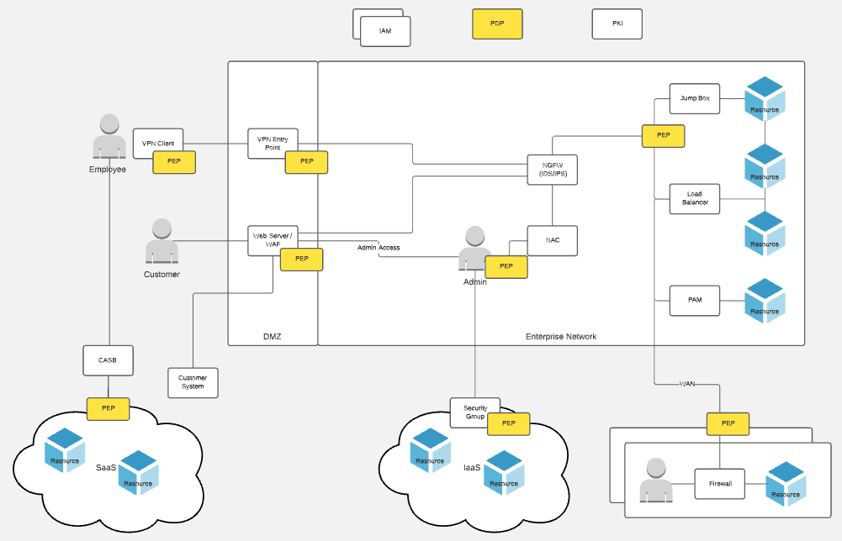
One Possible Solution

Slide 123
Architecting for Zero Trust

Slide 124
Architecting for Zero Trust
Threat Modeling
Assess & Classify Relevant Data & Data Sources
Identify Acceptable Zones of Implicit Trust
Identify Network-Related PEPs
Identify Infrastructure-Specific PEPs
Identify & prioritize potential attack vectors
Understand data sensitivity, compliance, & regulatory requirements for data
Identify small groups of components that should support implicit trust
Potential points of exposure in the target network topology
Potential points of exposure in the infrastructure that will be used (e.g., Cloud services, RDBMS, etc.)
Penetration Testing
Verify Adherence to Logging Policy for Local & Central SIEM
Assess Application Approach to Managing & Using Keys, Tokens, & Secrets
Ensure Required PEPs in Place or Add if Needed
Identify Application-Specific PEPs
Plan for the necessary testing to validate security of architecture & application workflow
Identify what needs to be logged, how it will be aggregated into SIEM, and confirm no exposure in logging detail
What are the sensitive pieces of configuration needed and what approach will be used to securely incorporate them
Use any available APIs or hooks to existing before creating custom
Additional AuthN/AuthZ requirements specific to the application

Slide 125




Thank you!
If you have additional questions, please reach out to me at:
(asanders@gamuttechnologysvcs.com)

